Slide 1
STP510A Week IV) The Geography of Innovation: Regional Innovation Systems Asheim, Rjorn, and Meric G. Gertler. 2012.
Euibeom Son
ubs5252@kaist.ac.kr

Slide 2
1. Globality vs. Regionality
2. Knowledge bases & Spatial proximity
3. Rational Innovation System (RIS)
4. Relation between RIS and NIS
5. Alternative: “communities of practice”
6. Remained questions

Slide 3
Globality vs. Regionality
“Innovative activity is not uniformly or randomly distributed across the geographical landscape”
The more knowledge-intensive the economic activity, the more geographically clustered it tends to be.
This tendency toward spatial concentration has become more marked over time, not less.
➔ If so, isn't geographical proximity leading the innovation process?

Slide 4
Tacit knowledge
1. Globality vs. Regionality
“When everyone has relatively easy access to explicit/codified knowledge, the creation of unique capabilities and products depends on the production and use of tacit knowledge”
Defies easy articulation or codification ➔ difficult to exchange over long distances
Related to socially organized learning processes: the interactions and knowledge flows between economic entities

Slide 5
Tacit knowledge
1. Globality vs. Regionality
Should it be physically concentrated?
Its transmission is best shared through face-to-face interaction between partners who already share some basic commonalities.
Localized capabilities and intangible assets may strengthen the centripetal pull
social asset support
= strong tendencies of path-dependent development
= be very difficult to emulate by would-be imitators in other regions
= basis of global competitiveness (“first mover” region)

Slide 6
Knowledge bases & Spatial proximity
Two types of knowledge bases: “analytical" and “synthetic"
Synthetic knowledge base
application or novel combination of existing knowledge
customer and supplier interaction
Analytical knowledge base
scientific knowledge (reasonable processes such as models)
university-industrial network
are more often codified (or readily codifiable)
⬅ more widely distributed?

Slide 7
Analytical knowledge base
2. Knowledge bases & Spatial proximity
“… no less spatially concentrated than those forms of innovative economic activity based on synthetic types of knowledge“
1) Knowledge spillover effects measured by indicators such as patent citations
- Patents more often cite other patents arising in the same city 2) If there is a star scientist (biology, pharmaceutics)
- The proportion of related start-ups around the area increases

Slide 8
Analytical knowledge base
2. Knowledge bases & Spatial proximity
3 Expected reasons
1) Quickly and easily occur on local networks before knowledge presentation becomes global.
2) Good for hiring highly educated workers. Provide a local labor market which is rich and deep enough to promise a continuous employment opportunities.
3) They want to work in a high-level city, so they actually get together there.

Slide 9
Analytical knowledge base
2. Knowledge bases & Spatial proximity
3 Expected reasons
1) Quickly and easily occur on local networks before knowledge presentation becomes global.
⬅ e.g. knowledge about failure
2) Good for hiring highly educated workers. Provide a local labor market which is rich and deep enough to promise a continuous employment opportunities. ⬅ Innopolis Daedeok?
3) They want to work in a high-level city, so they actually get together there. ⬅ e.g. Florida's low immigration barrier

Slide 10
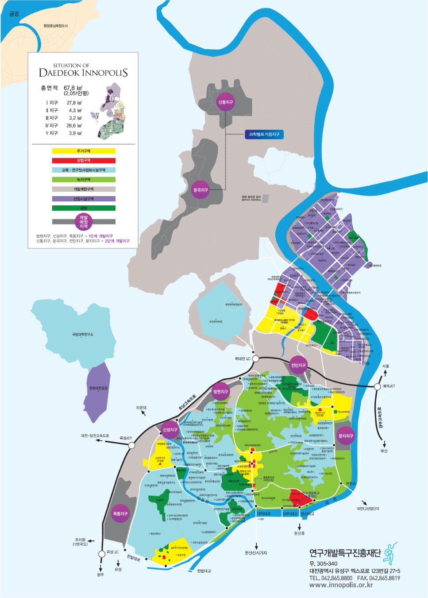
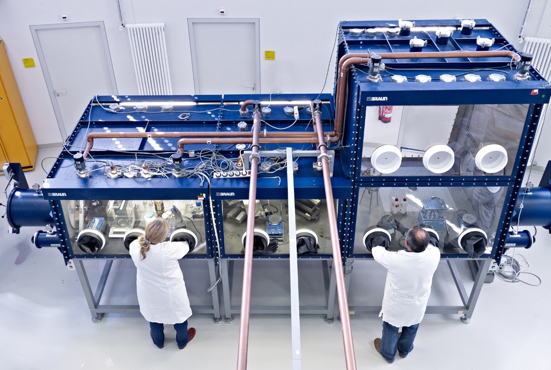
Notes:
https://www.pureairemonitoring.com/the-overview-on-inert-glove-boxes-and-how-they-work/
https://minwon.innopolis.or.kr/info/sub02_04.do

Slide 11
Innovation System
Narrowly: R&D of universities, public and private research institutes and companies
Broadly: Institutional setting that affects all aspects of economic structure and learning
⬄
Asheim distinguishes 3 types of rational innovation system (1998)
1)
2)
3)

Slide 12
Rational Innovation System (RIS)
“The regional innovation system can be thought of as the institutional infrastructure supporting innovation within the production structure of a region.”
- “following Freeman's use of the innovation system concept in his analysis of Japan's economy (1987)”
- first appeared in the early 1990s, same time that the idea of the national innovation system was examined in books by Lundvall (1992) and Nelson (1993).
inspired by the national innovation system concept
based on a similar rationale that emphasizes territorially based innovation systems
⬅

Slide 13
Substantive theoretical elements of RIS
3. Rational Innovation System (RIS)
Cooke, 2000
1. Evolutionary economic theory
2. Industrial district concept
- some patterns of successful areas: strong SMEs, intensive/horizontal cooperation between enterprises, top-level human resource, flexible employment, …
3. Theorizing of rationalization strategies
- reformation of the rigidities and inflexibility of the Fordist production model. - the entire value added process, including supplier-customer relationships, is the subject of a rationalization strategy
4. Governance concept
- hierarchy, markets, networks, and culture
- success depends on fit between them

Slide 14
System (RIS)
3. Rational Innovation System (RIS)
“The regional innovation system can be thought of as the institutional infrastructure supporting innovation within the production structure of a region.”
➔
Economic processes between individual clusters and national levels or enterprise levels
Consider the region as a means of connection between them

Slide 15
3 types of RIS
3. Rational Innovation System (RIS)
1) Territorially embedded regional innovation system
businesses and regions that mainly use synthetic knowledge
adaptive skills and organizational learning in a regional context
2) Regionally networked innovation system
A regional cluster of firms surrounded by a regional “supporting” institutional infrastructure
Ideal, ‘network RIS’
3) Regionalized NIS
innovation activity takes place primarily in cooperation with actors outside the region
e.g. clustering of R&D laboratories of large firms and/or governmental research institutes in planned “science parks.”

Slide 16
Relation between RIS and NIS
Cooke, 2003
Traditional IRIS(institutional regional innovation system)
German/North European, synthetic knowledge
a path-dependent tendency rather than destructive technology/innovation. ➔gradual evolution
⬄
new economy innovation system (NEIS) = entrepreneurial regional innovation system (ERIS)
UK/US, analytic knowledge
fewer system elements and are dynamic in entrepreneurship and markets

Slide 17
Cooke’s argument
4. Relation between RIS and NIS
“a general correspondence between the macroinstitutional characteristics of the economy and the dominant form and character of its regional innovation systems”
Coordinated market economies on the macro level support cooperative, long-term, and consensus-based relations between private as well as public actors
Germany (Baden-Württemberg)
⬄
Liberal market economies inhibit the development of these relations but instead offer the opportunity to quickly adjust formal structures to new requirements
US/UK

Slide 18
Alternative: “communities of practice”
Is RIS the best?
"Communities of Practice”: promoting the production and sharing of implicit and codified knowledge
- organizational or relational proximity and occupational similarity are more important than geographical proximity in supporting the production, identification, appropriation and flow of tacit knowledge
e.g. Multinational companies: ICT or air travel, etc.
- tacit knowledge may also flow across regional and national boundaries if organizational or “virtual community” proximity is strong enough

Slide 19
Remained Questions
What forces shape or defines this “relational proximity,” enabling it to transcend physical, cultural, and institutional divides? How are shared understandings produced?
Implicit knowledge becomes more structured and the difference is reduced. vs. The value of geographical proximity will be maintained and localized.
Is this analysis only valid for science-intensive industries?

